Slide 1


Interpreter

Slide 2
Intent
Given a language, define a representation for its grammar along with an interpreter that uses the representation to interpret sentences in the language.

Slide 3
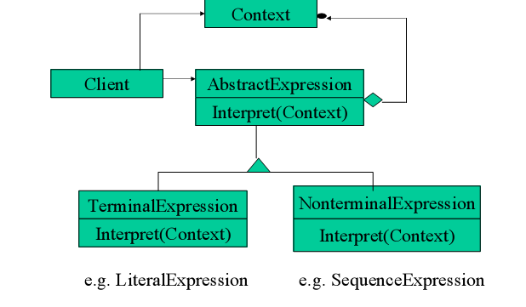
Structure

Slide 4
Pieces of the Interpreter (Participants)
Abstract Expression
Terminal Expressions
Non-Terminal Expression
Context
  Hold global information for the interpreter
Client
  Builds the Abstract Syntax Tree
  Invokes Interpret on the tree

Slide 5
Motivation (Example)
Assumption:
We have given a language.
Tough Questions:
How to represent grammar for languages?
Who will interpret that representation?
Answer: Interpreter pattern.
1.It describes how to define grammar for the given language.
2.It describes how to represents sentences in the language.
3.It describes how to interpret these sentences.

Slide 6
Flow of the Interpreter
Build the Abstract Syntax Tree
Interpret the tree in the given Context
  Each non-terminal node will interpret its children and return a result from that.
  Terminal nodes return actual values for non-terminal nodes to use.
  The context serves as a global data for interpreting the entire tree

Slide 7
Example Language: Arithmetic
Grammar
  Equation ::= Variable | Integer | Plus | Minus | Times | Divide | Mod | Negate | ‘(‘ Eq ‘)
    Terminal equations
      Variable::= ‘a’ | ‘b’ | ‘c’ …. |”ab” | …
      Integer::= 1 | 2 | 3 | 4 | 5 | 6 | …
    Non-Terminal equations
      Plus::= Eq ‘+’ Eq Minus::= Eq ‘-’ Eq Times::= Eq ’*’ Eq Divide::= Eq ‘-’ Eq Mod::= Eq ‘%’ Eq …Negate:: ‘-’ Eq

Slide 8
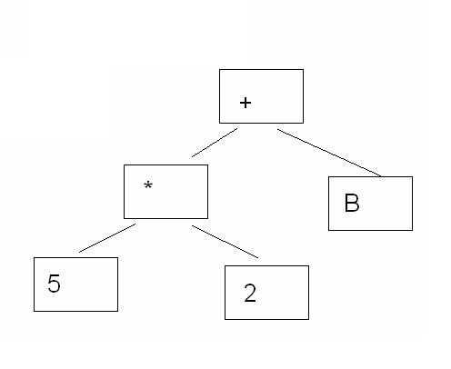
Abstract Syntax Tree Example
5 * 2 + B

Slide 9
Example grammar
Regular Expression:
Raining & (dogs | cats)*
Grammar:
  Expression::= literal | sequence
  Literal ::= ‘a’|’b’|……. { ‘a’|’b’|….}*
  Sequence::= expression ‘&’ expression

Slide 10
How Interpreter will do this?
The grammar above is represented by 3 classes. An abstract class RegularExpression, and its 2 subclasses LiteralExpression and SequenceExpression. i.e. Interpreter pattern uses a class to represent each grammar rule.
Symbols on the right-hand side of the rules are instance variables of the these classes.
Define the interpret operation on each subclass of regular
Expression.
We can create an interpreter for these regular expressions.

Slide 11
Applicability
When the use of Interpreter will be best ?
  If the grammar is simple. For complex grammars, the class hierarchy for the grammar becomes large and unmanageable. Parser generators are a better alternative in such cases.
  If efficiency is not a critical concerns. The most efficient interpreters are usually not implemented by interpreting parse trees directly but by first translating them into another form.

Slide 12
Collaborations
The client builds the sentence as an abstract syntax tree of Non-terminal Expression and Terminal Expression instances.
The client initializes context and invokes the interpret operation.
Each Non-terminal Expression node defines Interpret in terms of Interpret on each sub-expression.
The Interpret operations at each node use the context to store and access the state of the Interpreter.

Slide 13
Implementation
Creating the abstract syntax tree
  Interpreter pattern doesn’t explain how to create an abstract syntax tree.
Defining the interpret operation
  If defining new operations is very common, it’s better to use the Visitor pattern.
Sharing terminal symbols with Flyweight pattern
  Grammars whose sentences contain many occurrences of a terminal symbol might benefit from sharing a single copy of that symbol.

Slide 14
Related Patterns
Composite: The abstract syntax tree is an instance of the composite pattern.
Flyweight: shows how to share terminal symbols within the abstract syntax tree.
Iterator: The interpreter can use Iterator to traverse the structure.
Visitor: can be used to maintain the behavior in each node in the abstract syntax tree in one class.

Slide 15
Consequences
Easily extensible grammar
Implementing grammar is easy
Complex grammar is difficult to manage
Can easily add new ways to interpret expressions through the Visitor.

Slide 16
Common uses
Widely used in compilers that are implemented with an OO language
Any case where you use the Composite Pattern to represent a language

Slide 17
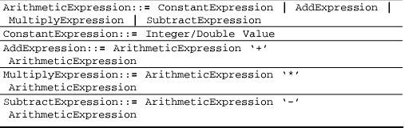
Grammar Rules for Arithmetic Expressions

Slide 18
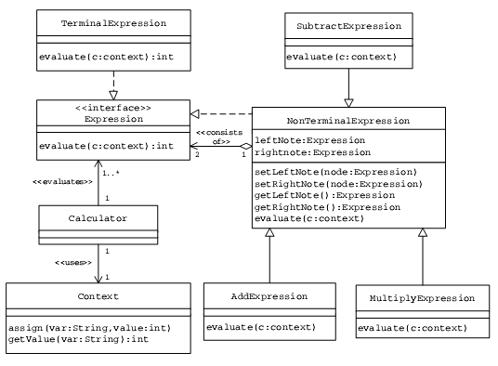
Class Hierarchy representing Grammar Rules for Arithmetic Expressions

Slide 19
Code
public interface Expression {
public int evaluate(Context c);
}
public class TerminalExpression implements Expression {
private String var;
public TerminalExpression(String v) {
var = v;
}
public int evaluate(Context c) {
return c.getValue(var);
}
}

Slide 20
Code
public abstract class NonTerminalExpression implements Expression {
private Expression leftNode;
private Expression rightNode;
public NonTerminalExpression(Expression l, Expression r) {
setLeftNode(l);
setRightNode(r);
}
public void setLeftNode(Expression node) {
leftNode = node;
}

Slide 21
Code
public void setRightNode(Expression node) {
rightNode = node;
}
public Expression getLeftNode() {
return leftNode;
}
public Expression getRightNode() {
return rightNode;
}
}

Slide 22
Code
class AddExpression extends NonTerminalExpression {
public int evaluate(Context c) {
return getLeftNode().evaluate(c) + getRightNode().evaluate(c);
}
public AddExpression(Expression l, Expression r) {
super(l, r);
}
}

Slide 23
Code
class MultiplyExpression extends NonTerminalExpression {
public int evaluate(Context c) {
return getLeftNode().evaluate(c) *
getRightNode().evaluate(c);
}
public MultiplyExpression(Expression l, Expression r) {
super(l, r);
}
}

Slide 24
Code
The Calculator object carries out the interpretation and evaluation of the input expression in three stages:
Infix-to-postfix conversion — The input infix expression is first translated into an equivalent postfix expression.
Construction of the tree structure — The postfix expression is then scanned to build a tree structure.
Postorder traversal of the tree — The tree is then postorder traversed for evaluating the expression.

Slide 25
Code
public class Calculator {
public int evaluate() {
String pfExpr = infixToPostFix(expression);
class Context {
private HashMap varList = new HashMap();
public void assign(String var, int value) {
varList.put(var, new Integer(value));
}
public int getValue(String var) {
Integer objInt = (Integer) varList.get(var);
return objInt.intValue();
}

Slide 26
Code
public Context() {
initialize();
}
private void initialize() {
assign("a”,20);
assign("b”,40);
assign("c”,30);
assign("d”,10);
}
}
Expression rootNode = buildTree(pfExpr);
return rootNode.evaluate(ctx);
}
}

